Slide 1
Interdependent Relationships

Slide 2
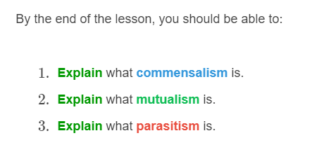
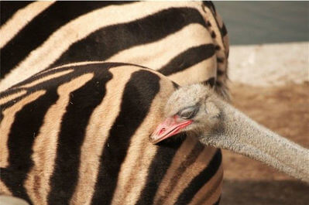

Slide 3
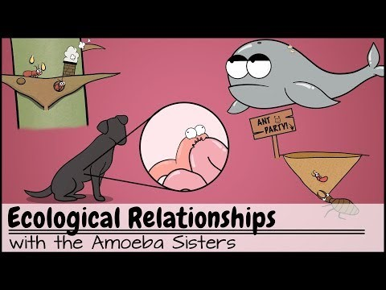

Slide 4
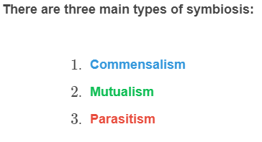
The organisms in an ecosystem are interdependent.
It means that they are depending on each other for survival.
Interdependence is also known as symbiosis.
There are three main types of symbiosis:

Slide 5
Commensalism is a symbiotic relationship in which one species benefits, and the other is not affected.
The second species is neither helped nor harmed by the interaction.

Slide 6
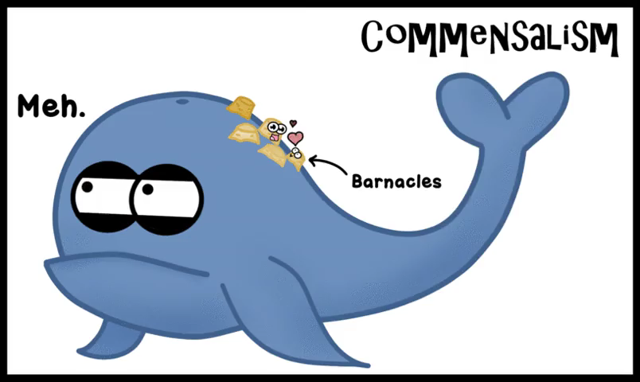
An example of commensalism is the barnacles that attach themselves to the bodies of whales.
The barnacles benefit by gaining access to more feeding opportunities than they would have if they stayed in the same place. The whales are unaffected.

Slide 7
Mutualism is a symbiotic relationship that benefits both species.

Slide 8
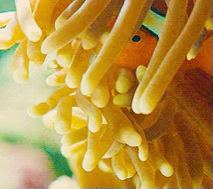
An example of mutualism is a clownfish and anemone.
Anemones provide a safe and protective home for clownfish.
In return, clownfish clean the anemones, provide them with food and protect them from predatory fish!
It's a win win!

Slide 9
Parasitism is a symbiotic relationship in which one species benefits and the other is harmed.
In this interaction, the parasite obtains its nourishment from the host.

Slide 10
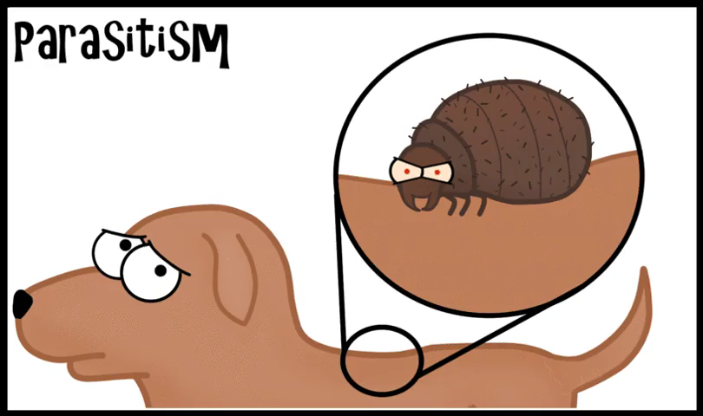
An example of parasitism are fleas on a dog.
Fleas harm their dog hosts by biting their skin, sucking their blood, and causing them to itch.

